Slide 1


Optimization of enzyme combinations for shotgun proteomics
Sabrina Khuntia
Gao Lab (College of Pharmacy)

Slide 2

Introduction

Slide 3
Outline

Slide 4
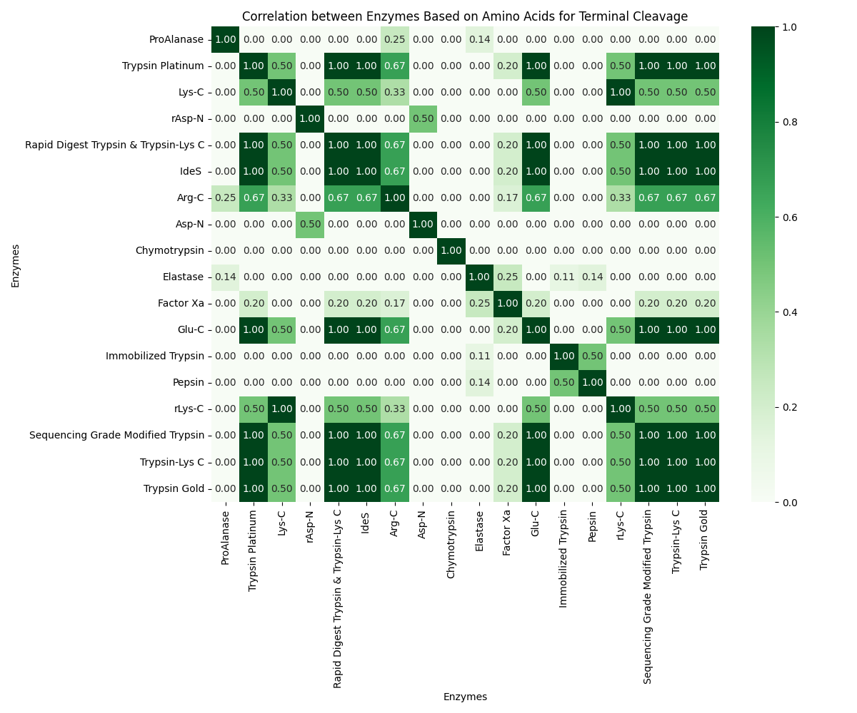

Slide 5
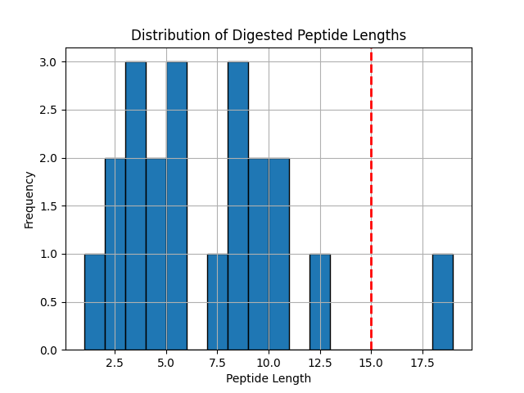
Cleaved peptides using [‘trypsin’] :
Number of peptides that satisfy the mass spectrometer's detectability conditions:
10
Average size of digested peptides: 6.523809523809524
Maximum size of undigested peptides:
19

Slide 6
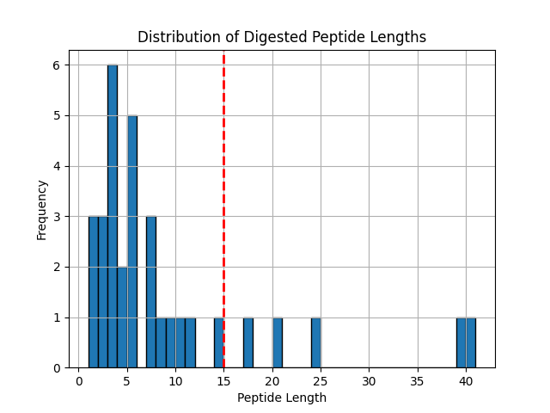
Cleaved peptides using ['chymotrypsin', 'rasp-n'] :
Number of peptides that satisfy the mass spectrometer's detectability conditions: 11
Average size of digested peptides: 8.5625
Maximum size of undigested peptides: 41

Slide 7
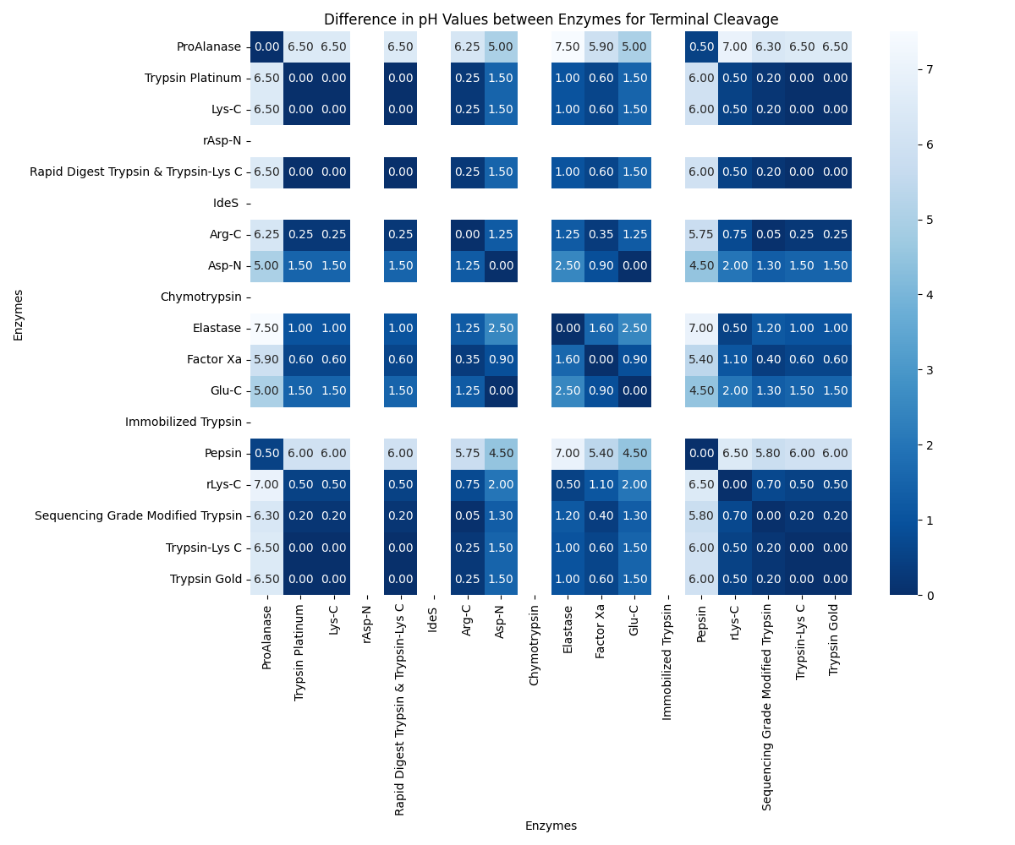

Slide 8
Other Parameters

Slide 9
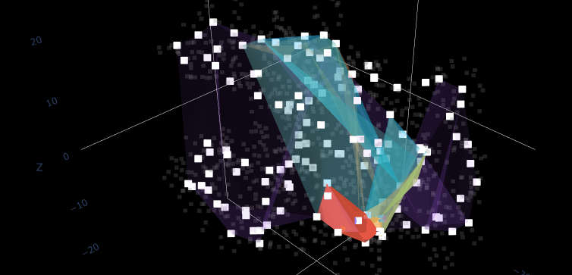
Parameter: Hull Layers

Slide 10

Thank you!

